Slide 1

Benefits of Golang for Distributed Computing
Alex Nassif
Dennis La

Slide 2

Intro to Go
Developed by Google in 2009
Born out frustration by languages such as Java and C++
Google needed a language better suited for network servers and distributed systems

Slide 3






Companies using Go

Slide 4
Language Characteristics
Compiled to machine code
Statically Typed
Garbage Collection
Native Concurrency
Go compiles into a single binary file
Requires less RAM and you don’t need to install anything else such as, for example, a JVM

Slide 5

Concurrency
Concurrency model → CSP aka Communicating Sequential Processes
“Don’t communicate by sharing memory, share memory by communicating”
Paradigm created by Charles Hoare in 1978
He saw issues with communication between processes executing concurrently and sharing memory
Implemented in Go by goroutines and channels

Slide 6
Goroutines
Are used to enable concurrency
“Keyword” go
Nonpreemptive coroutines
Super lightweight
Stack size is 2 KB per goroutine vs. Java’s 1 MB or more OS thread
Stack size of goroutine is resizeable

Slide 7
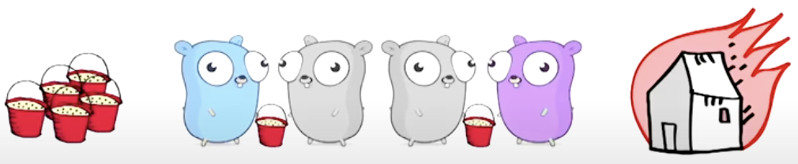
Channels
Mechanism used for communication between goroutines
Sends and receives are blocking
Allows goroutines to synchronize without explicit locks and condition variables
Deadlock can occur if a channel is sending data then it is expected that another goroutine will receive it and vice versa.

Slide 8
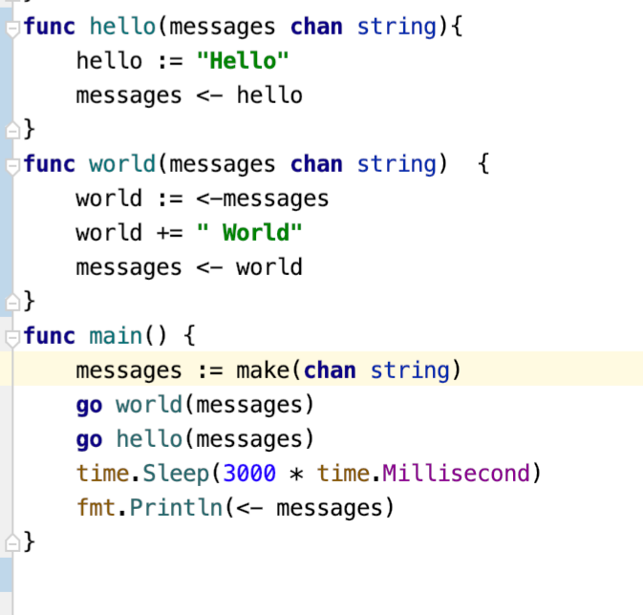
Goroutines and Channels working together

Slide 9
Go Runtime
Manages goroutines, channels and goroutine scheduler
Intermediary between Go program and OS
All the OS sees is a process running on user space
Goroutine scheduler is key
Scheduler keeps track of all the goroutines and threads they are run on
If a goroutine blocks then the scheduler creates another thread so other goroutines can continue to work
M:N Scheduler - faster context switching, takes advantage of “virtual processors”

Slide 10



Performance Comparison to Java
Popular object-oriented programming language
Uses Java Threads and Runnable interface
Explicit concurrency model → Use manages locks and mutexes explicitly
Used in many big companies and applications
Android (Google), Uber, Airbnb etc.

Slide 11
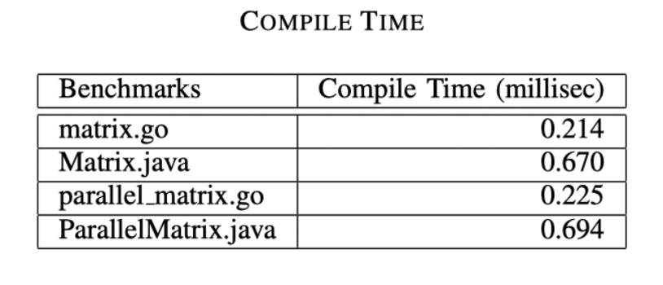
Performance Comparison to Java
Compilation time case study: Matrix Multiplication
Go avoids dependency analysis of C-style library/file imports → Less overhead
3X speed up
Source: N. Togashi and V. Klyuev, “Concurrency in go and java: Performance analysis,” in 2014 4th IEEE International Conference on Information Science and Technology, 2014, pp. 213–216.

Slide 12
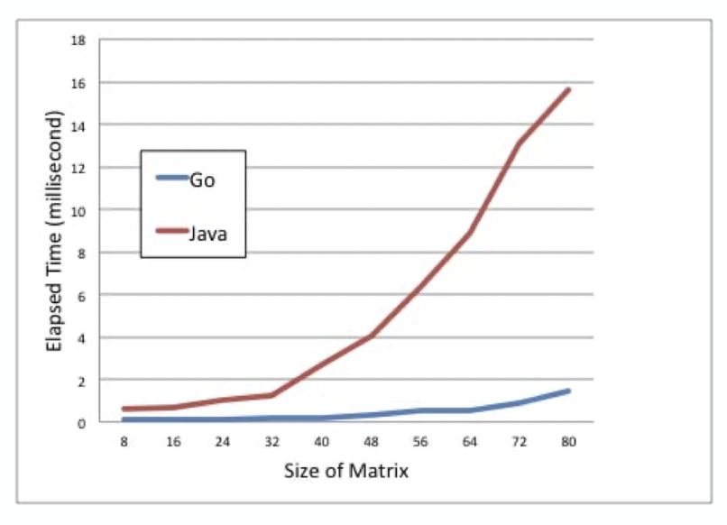
Performance Comparison to Java
Execution time case study: Matrix Multiplication
High cost for creation of Java Threads
Go compiles to machine code, Java compiles to bytecode
Source: N. Togashi and V. Klyuev, “Concurrency in go and java: Performance analysis,” in 2014 4th IEEE International Conference on Information Science and Technology, 2014, pp. 213–216.

Slide 13



Performance Comparison to Erlang
Functional and dynamically typed language
Actor concurrency model → Uses message passing like Go
Helps reduce pitfalls of shared memory like deadlocks and race conditions
Used in multiplayer games like Call of Duty and League of Legends
Used in messaging app known as WhatsApp

Slide 14
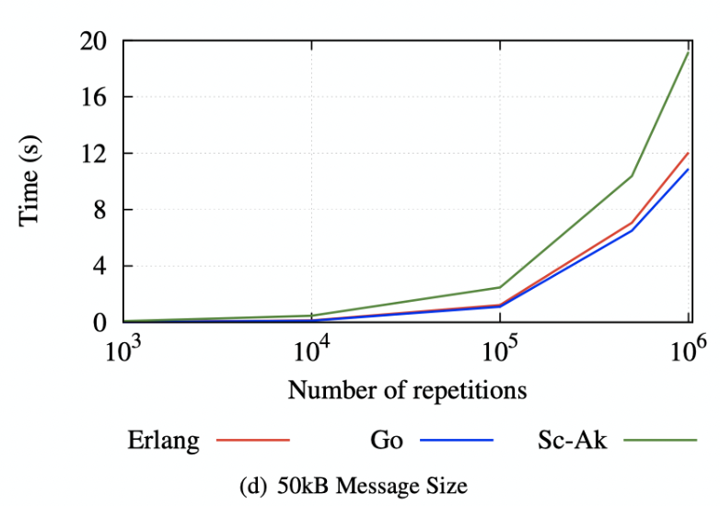
Performance Comparison to Erlang
Communication latency case study:
Measures time taken to pass a message of given size back and forth for a given number of repetitions
Go is slightly faster than Erlang
Source: I. Valkov, N. Chechina, and P. Trinder, “Comparing languages for engineering server software: Erlang, go, and scala with akka,” in Proceedings of the 33rd Annual ACM Symposium on Applied Computing, ser. SAC ’18. New York, NY, USA: Association for Computing Machinery, 2018, p. 218–225. [Online].

Slide 15
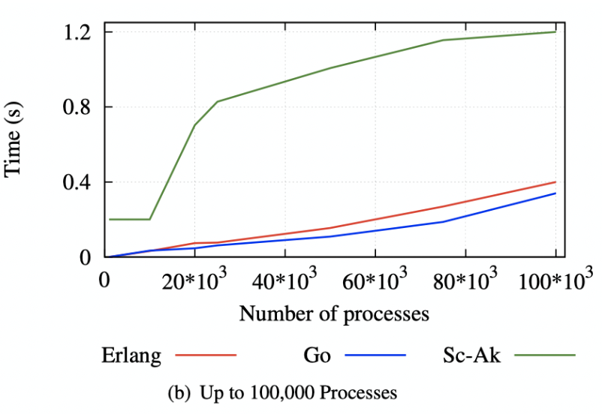
Performance Comparison to Erlang
Process creation time case study:
Measures time taken to spawn a given number of processes
Go is slightly faster than Erlang
Source: I. Valkov, N. Chechina, and P. Trinder, “Comparing languages for engineering server software: Erlang, go, and scala with akka,” in Proceedings of the 33rd Annual ACM Symposium on Applied Computing, ser. SAC ’18. New York, NY, USA: Association for Computing Machinery, 2018, p. 218–225. [Online].

Slide 16
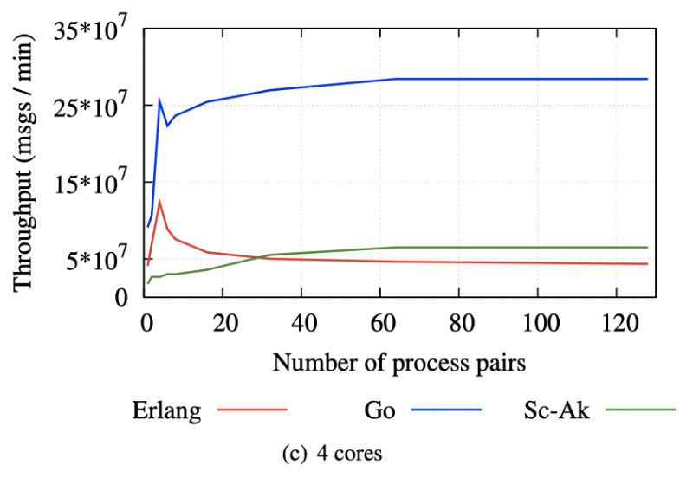
Performance Comparison to Erlang
Concurrency throughput case study:
Measured message exchange rate between pairs of processes
Erlang is dynamically typed → Need to type check messages at runtime
Source: I. Valkov, N. Chechina, and P. Trinder, “Comparing languages for engineering server software: Erlang, go, and scala with akka,” in Proceedings of the 33rd Annual ACM Symposium on Applied Computing, ser. SAC ’18. New York, NY, USA: Association for Computing Machinery, 2018, p. 218–225. [Online].

Slide 17



Performance Comparison to Scala
Functional, object-oriented and statically typed language
Actor concurrency model → Uses message passing like Go
Helps reduce pitfalls of shared memory like deadlocks and race conditions
Used by big companies like LinkedIn, Twitter and Netflix

Slide 18
Performance Comparison to Scala
Communication latency case study:
Measures time taken to pass a message of given size back and forth for a given number of repetitions
Scala with has highest communication latency
Source: I. Valkov, N. Chechina, and P. Trinder, “Comparing languages for engineering server software: Erlang, go, and scala with akka,” in Proceedings of the 33rd Annual ACM Symposium on Applied Computing, ser. SAC ’18. New York, NY, USA: Association for Computing Machinery, 2018, p. 218–225. [Online].

Slide 19
Performance Comparison to Scala
Process creation time case study:
Measures time taken to spawn a given number of processes
Scala has the longest process creation time by a large margin
Source: I. Valkov, N. Chechina, and P. Trinder, “Comparing languages for engineering server software: Erlang, go, and scala with akka,” in Proceedings of the 33rd Annual ACM Symposium on Applied Computing, ser. SAC ’18. New York, NY, USA: Association for Computing Machinery, 2018, p. 218–225. [Online].

Slide 20
Performance Comparison to Scala
Concurrency throughput case study:
Measured message exchange rate between pairs of processes
Scala had the lower throughput by a large margin compared to Go
Source: I. Valkov, N. Chechina, and P. Trinder, “Comparing languages for engineering server software: Erlang, go, and scala with akka,” in Proceedings of the 33rd Annual ACM Symposium on Applied Computing, ser. SAC ’18. New York, NY, USA: Association for Computing Machinery, 2018, p. 218–225. [Online].

Slide 21
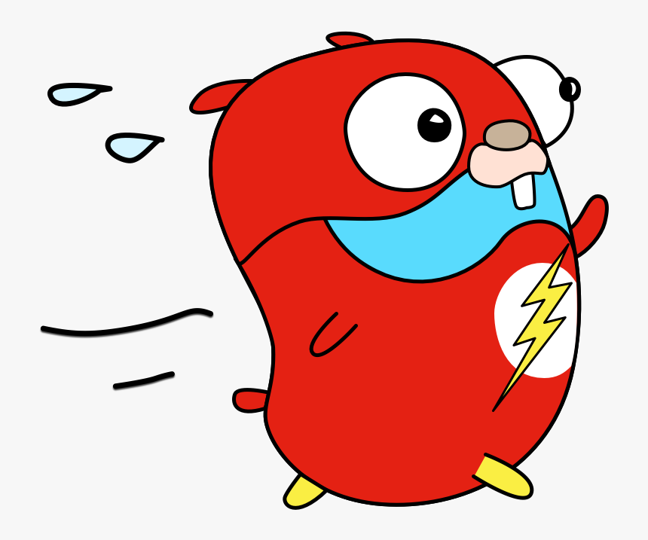
Performance Comparison to Scala
Explanations:
Study used Scala with Akka Framework → Messages passed between actors are dynamically typed instead of statically typed
Overhead
Scala compiles to bytecode like Java, but Go compiles to machine code
Go naturally faster

Slide 22
Demo

Slide 23
Thank you!

